Slide 1
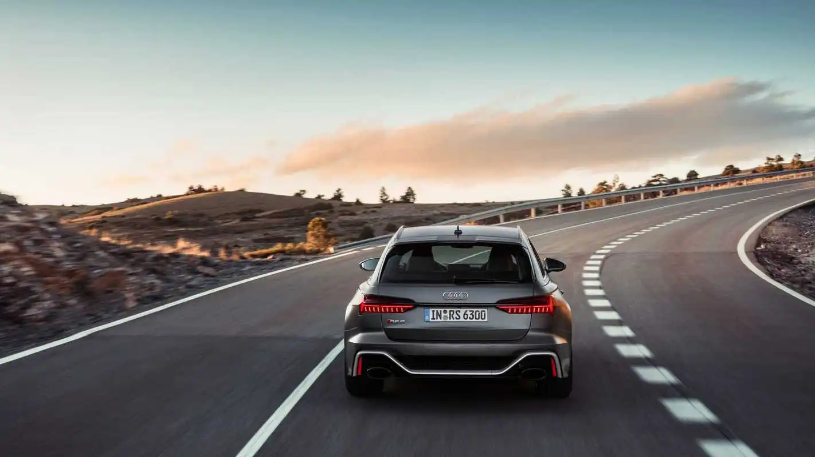
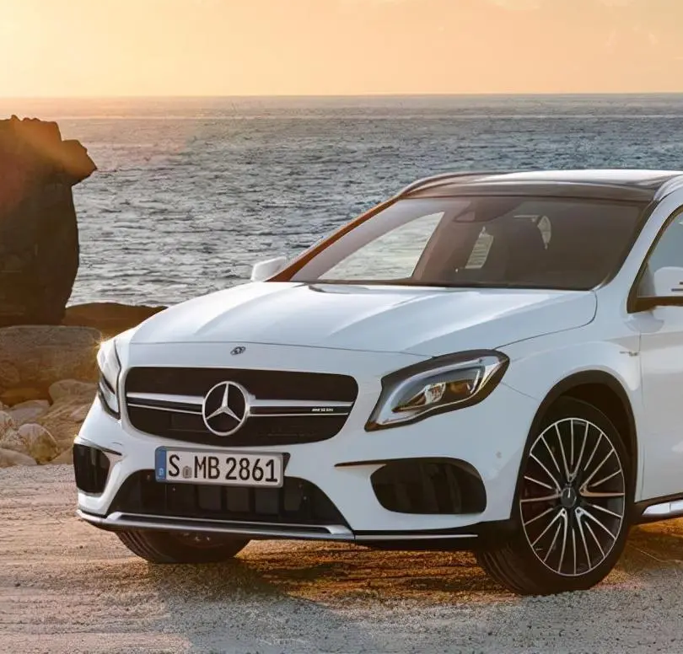
Vehicle License Plate Recognition
Computer vision and Image processing
Melantha Wang 1129627
Aurora Jin 1129371

Slide 2
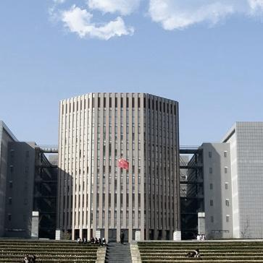
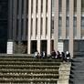
01
Introduction
02
Modules Related
CONTENTS
03
Code Explanation
04
Result

Slide 3

Introduction
PART 01

Slide 4
Vehicle License Plate Recognition (VLPR)
An application of computer image recognition technology
Using optical character recognition on images to read vehicle registration plates
Application:
ETC
Monitoring and alarm
Violation punishment
Vehicle access management

Slide 5
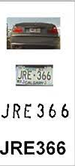
Vehicle License Plate Recognition (VLPR)
Primary Algorithm
Plate localization
Plate orientation and sizing
Normalization
Character segmentation
Optical character recognition
Syntactical/Geometrical analysis
Eliminate common influences

Slide 6
Modules Related
PART 02

Slide 7
WHAT WE USE
openCV
imutils
numpy
pytesseract

Slide 8
openCV
An open source library for video analysis, image analysis and other computer vision fields
What it supports：
image reading & writing
image information acquisition (such as shape, height, width and pixel)
rotation, cropping and blurring of the image
image edge detection
cv2.imread('path of the image file')
cv2.imwrite(’path of the image file‘)
cv2.imread('photo.jpg')
print(img.shape)
cv2.getRotationMatrix2D((width / 2, height / 2), 70, .5)
cv2.warpAffine(img, rotation_matrix, (width, height))
cv2.transpose()

Slide 9
eg.
imutils.translate()
imutils.rsize()
imutils.rotate()
imutils.rotate_bound()
imutils
A package based on OpenCV, or can be considered as an interface of it
What it supports：
image translation, rotation, scaling, skeletonization and so on

Slide 10
NumPy
An open-source library for working efficiently with arrays
Provides more efficient storage and data operations as the arrays grow larger in sizeimage reading & writing
Pytesseract
A wrapper for Google’s Tesseract-OCR Engine. It is also useful as a stand-alone invocation script to tesseract, as it can read all image types supported by the Pillow and Leptonica imaging libraries, including jpeg, png, gif, bmp, tiff, and others

Slide 11
Code Explanation
PART 03

Slide 12
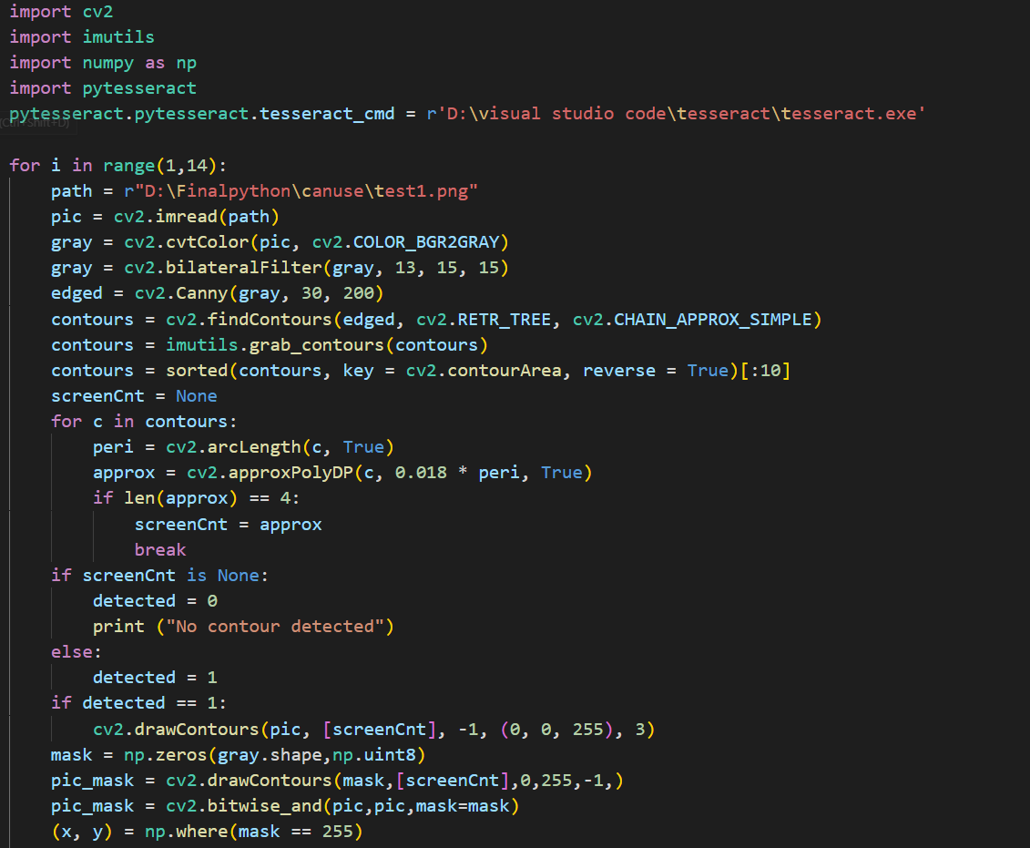
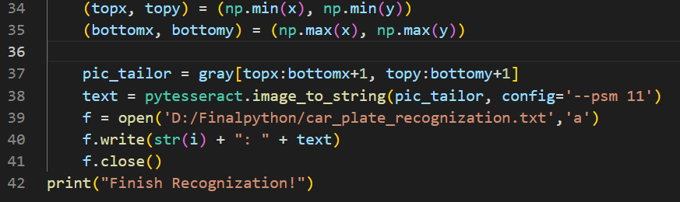

License Plate Positioning
Character Segmentation
Character Recognition
Functions

Slide 13
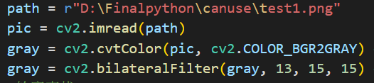
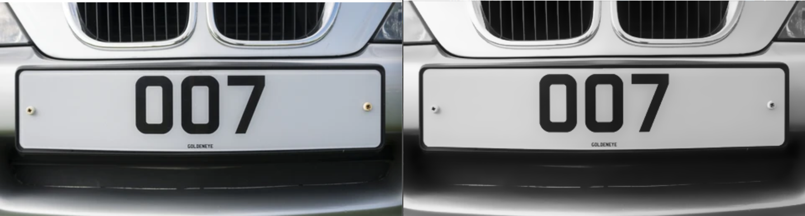
License Plate Positioning
cv2.imread(image_url): read the image file, change the image format to BGR format
cv2.cvtColor(image, cv2.COLOR_BGP2GRAY): Color space conversion function
cv2.COLOR_BGP2GRAY: Convert BGR format to grayscale image
Bilateral Filtering: can do edge preseving, based on Gaussian filter, which blur the edges a lot
cv2. bilateralFilter(source_image, diameter of pixel, sigmaColor, sigmaSpace):
diameter of pixel: The diameter of each pixel's neighborhood during filtering. >0, will automatically decided by signmaSpace
other two parameter: >15, more background information will be blured.

Slide 14
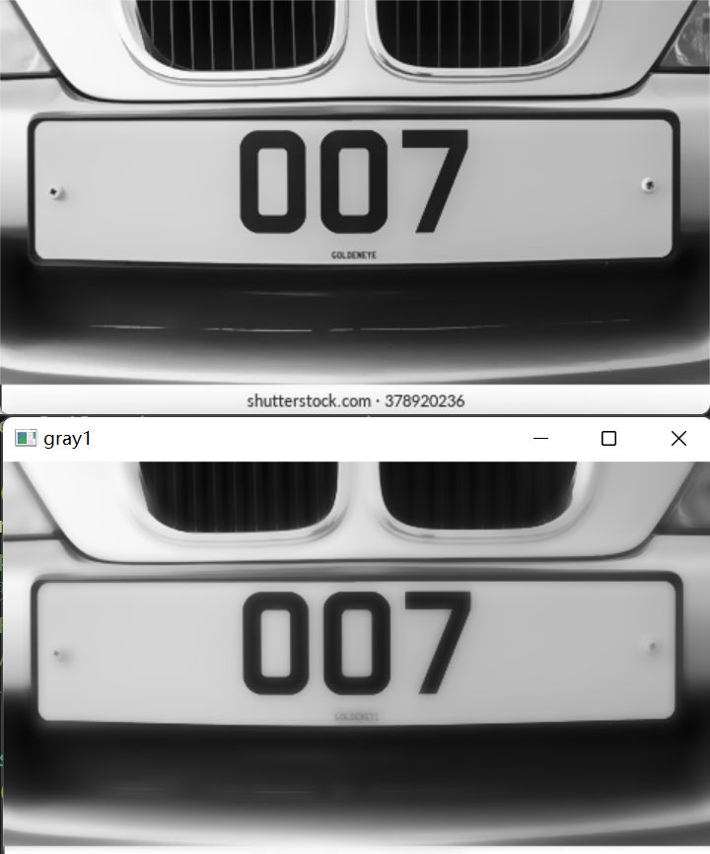
License Plate Positioning
Why use 13, 15, 15

Slide 15
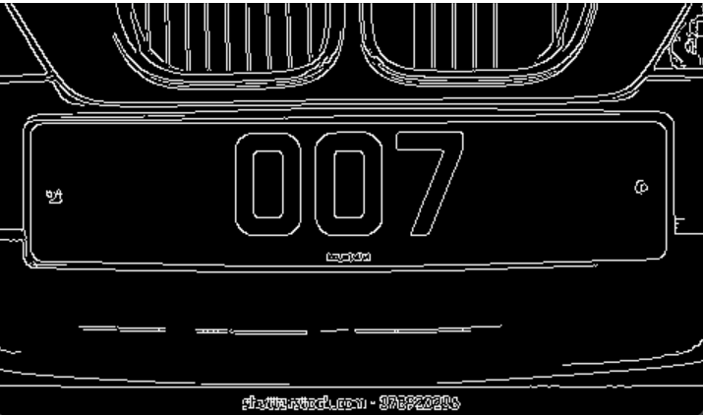
License Plate Positioning
Border Detection:
cv2.Canny（image，thresholdValue1，thresholdValue2): 30, 200 are minimum, maximum threshold value, show the Edges whose intensity gradient between this range.

Slide 16

License Plate Positioning
if 90, 100:
1: 007
2: K:PC1313
3: 4: DL4CAF4943!
5: TN21AT 7506
6: 1217
7: 39266
93
8: 9: GD70 EOO
10: MH12DE1433
if 80, 100:
1: 007
2: K:PC1313
3: 4: DL4CAF4943|
5: TN21AT 7506
6: 1217
7: 39266
93
8: 9: GD70 EOO
10: MH12DE1433
if 70, 100:
1: 007
2: K:PC1313
3: 4: DL4CAF4943!
5: TN21AT 7506
6: 1217
7: 39266
93
8: 9: GD70 EOO
10: MH12DE1433
if 60, 100:
1: 007
2: K:PC1313
3: 4: DL4CAF4943
5: TN21AT 7506
6: 1217
7: 39266
93
8: 9: GD70 EOO
10: MH12DE1433

Slide 17
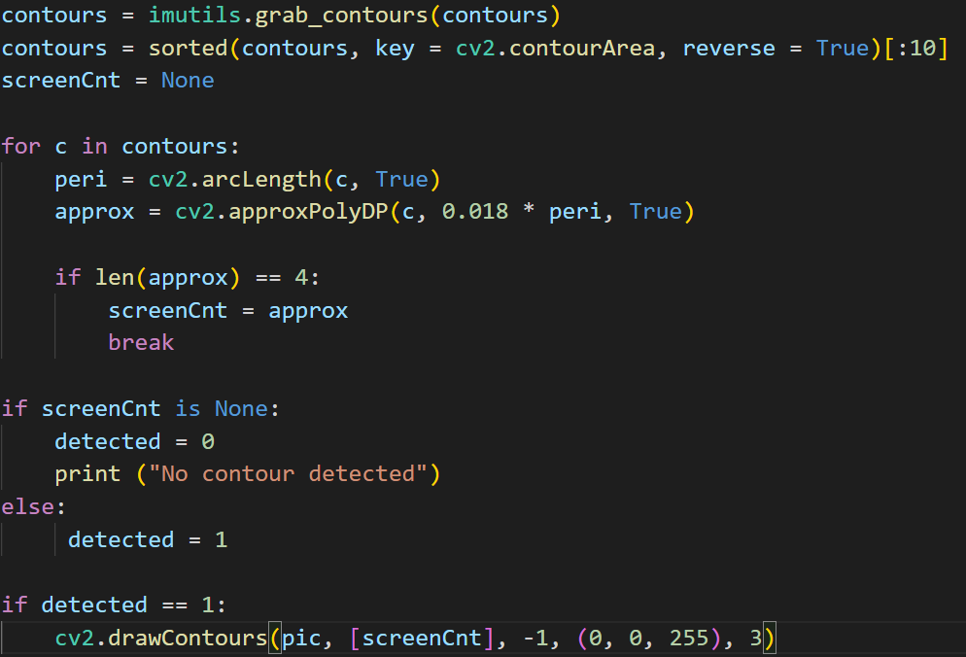
License Plate Positioning
findContours() : type (tuple)
use Binary image (edged)
mode (RETR_TREE): All contours are detected, and all contours build a hierarchical tree structure.
cv2.CHAIN_APPROX_SIMPLE: Only save the inflection point information of the contour, save all the points at the inflection points of the contour into the contours vector, and the information points on the straight line segment between the inflection point and the inflection point are not preserved.
imutils.grab_contours: type (tuple)
return countours, got from findContours()

Slide 18
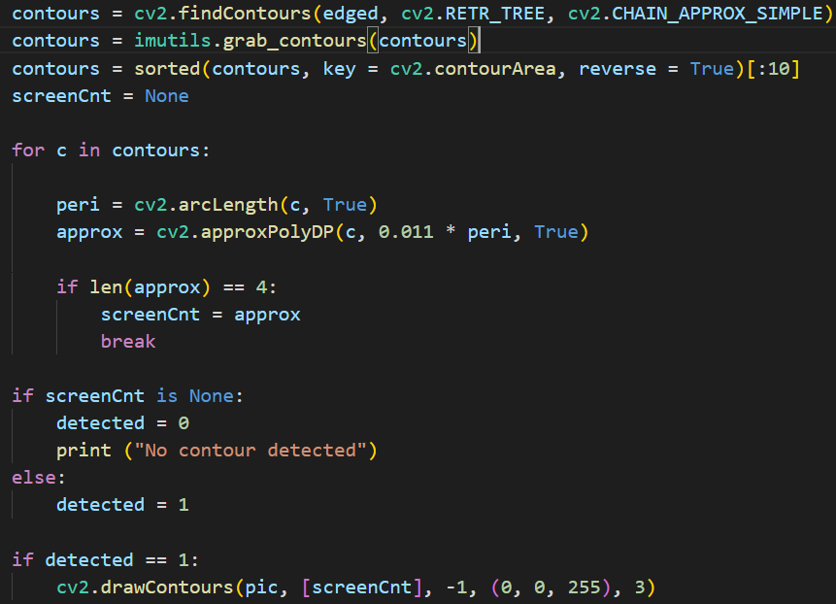
License Plate Positioning
sorted(): type (list)
Sort by area size from smallest to largest, considering only the first 10 results
cv2.arcLength(): Whether the contour is closed
cv2approxPolyDP(): get a closed border
If the closed contour is 4 sides, that is, a quadrilateral, pass the position value to screenCnt, (array)
If no value is passed in screenCnt, show no contour found
If found then detected is 1, then draw all contours with red lines on the pic picture

Slide 19
License Plate Positioning
if 0.011:
1: 007
2: K:PC1313
3: 4: DL4CAF4943
5: TN21AT 7506
6: 1217
7: 39266
93
8: 9: GD70 EOO
10: MH12DE1433
if 0.01:
1: 007
2: K:PC1313
3: 4: DL4CAF4943
5: TN21AT 7506
6: 1217
7: 39266
93
8: 9: GD70 EOO
10: MH12DE1433
if 0.009:
1: 007
2: K:PC1313
3: 4: “DL4CAF4943
5: TN21AT 7506
6: 1217
7: 39266
93
8: 9: GD70 EOO
10: MH12DE1433
if 0.008:

Slide 20
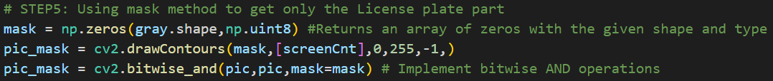


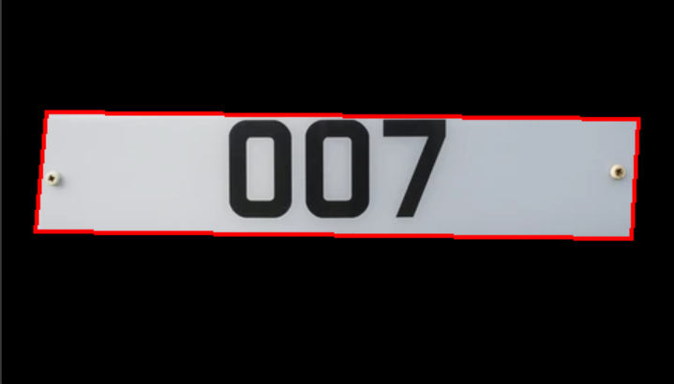
License Plate Positioning
np.zeros(dimension, data_type)：Create an array of size gray.shape, the data type is np.uint8, and fill in all 0s
gray.shape: return the height and width of the image, gray
np.uint8: return unsigned integer (0 to 255)
bitwise_and(src1, src2, dst=None, mask=mask): Display the image corresponding to the blank part of the original image and keep the black area

Slide 21
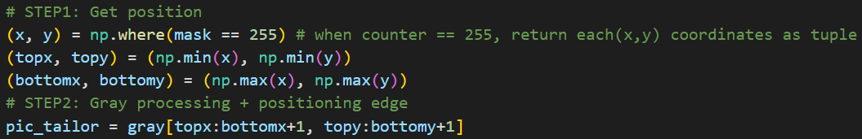
Character Segmentation
STEP1: Get the location coordinates of the license plate
1. np.where(mask==255): Returns the x,y coordinates of the white part of the image after occluding the background (255: white)
2. np.min: return minimun
3. np.max: return maximum
STEP2: Crop the grayscaled and denoised image according to the given x, y coordinates
[topx: bottomx]: return the element in the range [topx, bottomx-1]→[topx: bottomx+1]

Slide 22
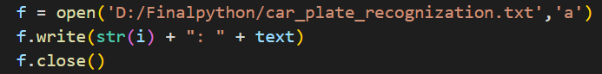
Character Recognition
pytesseract: Common models for verification code and character recognition; The bottom layer is the Tesseract recognition engine, encapsulated in the Python language
image_to_string(image, config='')
--psm 11: find as much text as possible
open(url, mode): (1) open the file in the specific position (2) Open for appending at the end of the file without truncating it (won't delete original content). Creates a new file if it does not exist.
write(content): numerical order: recognition result
close(): close an open file

Slide 23
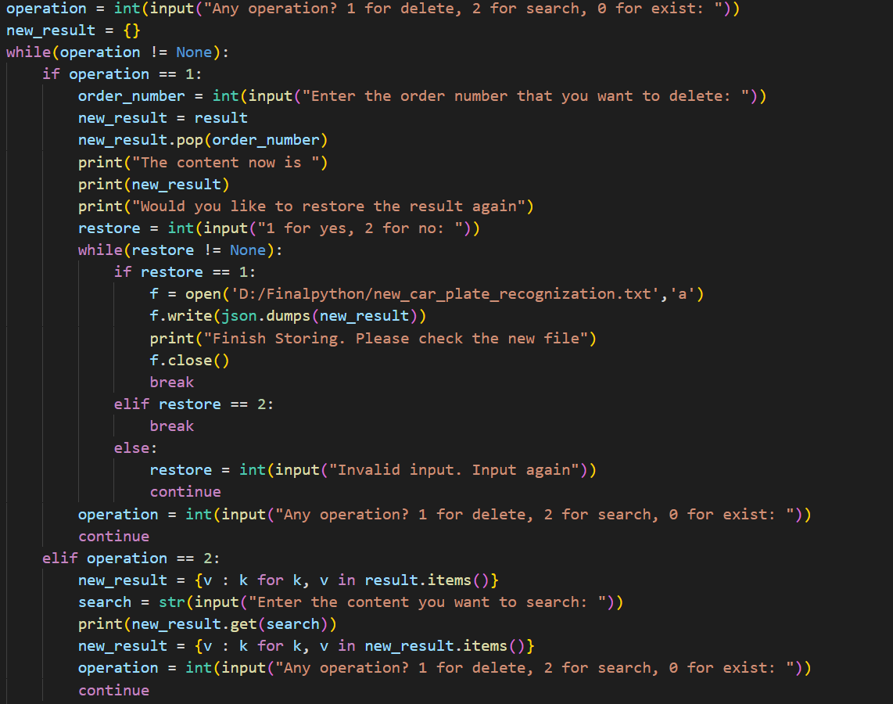
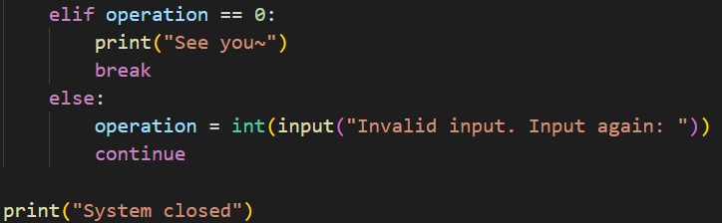
Function: delete&search

Slide 24
Result
PART 04

Slide 25
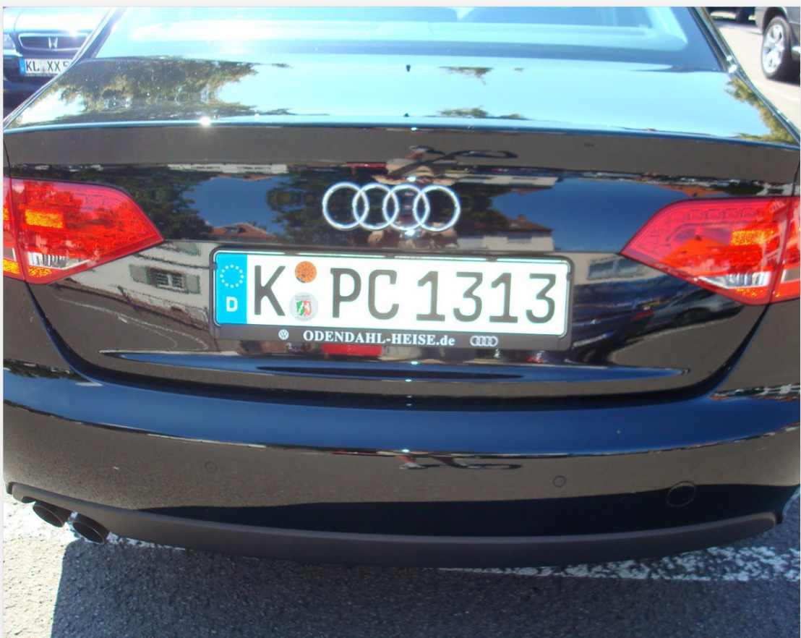
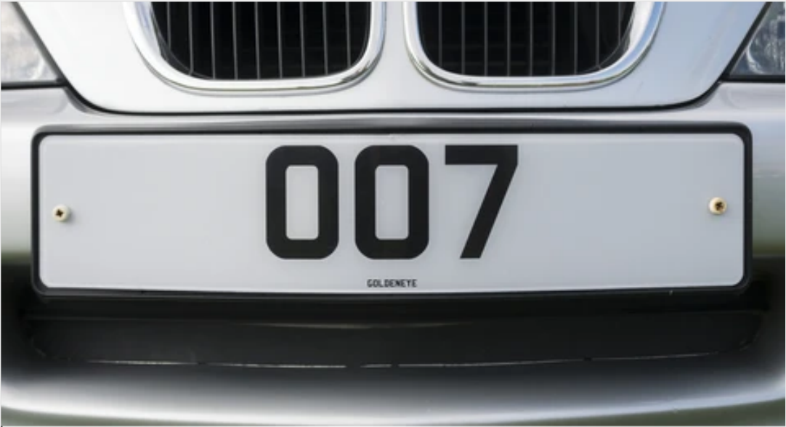
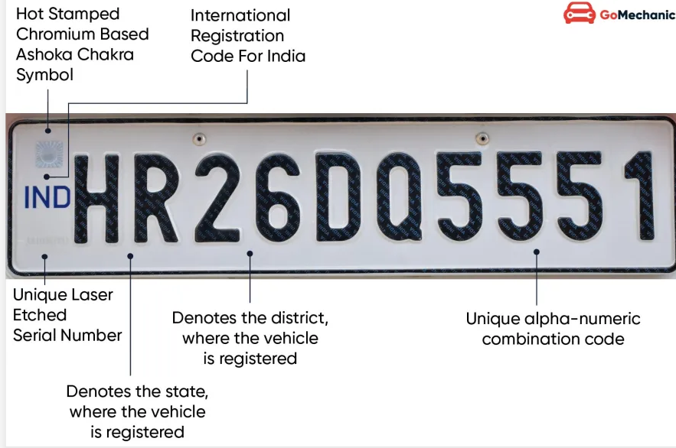
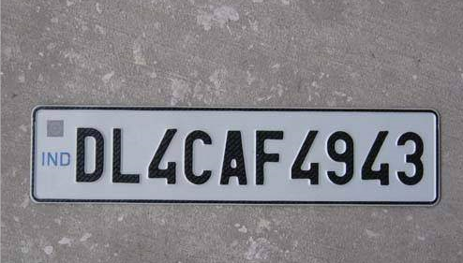
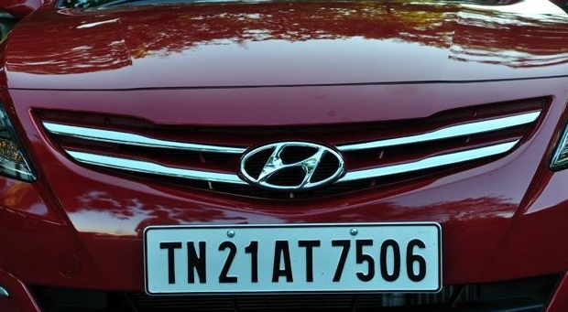
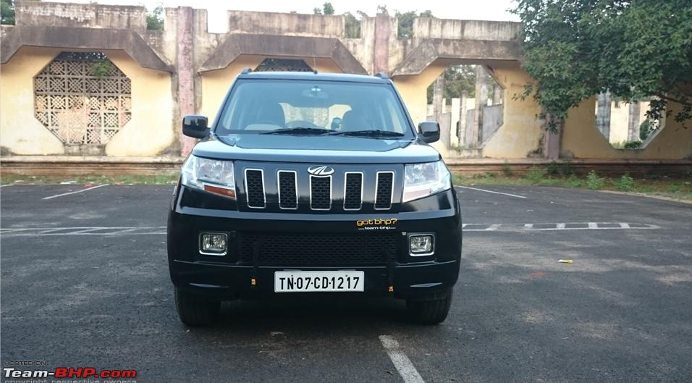
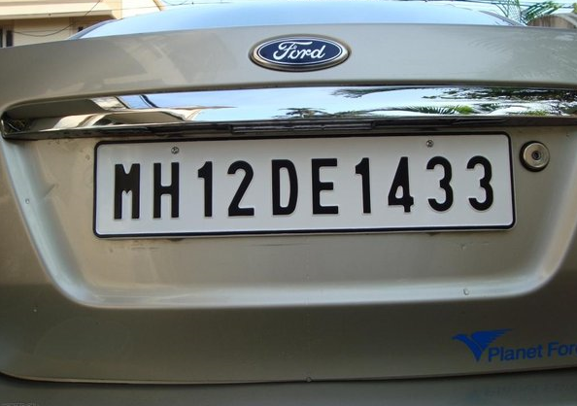
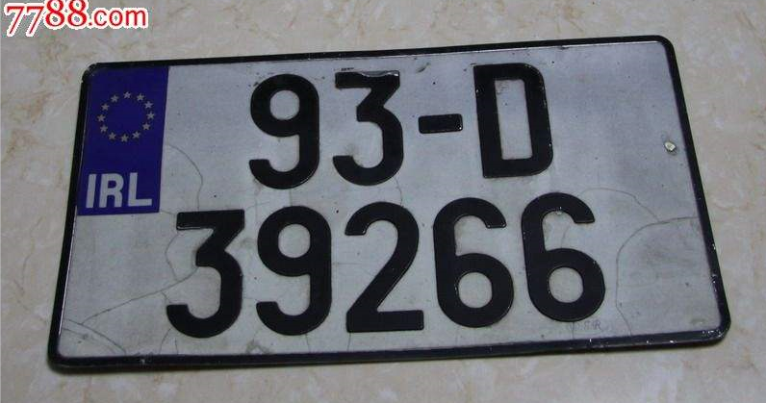
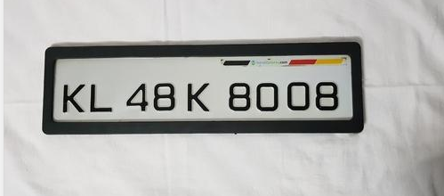
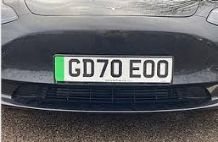
2
1
3
Result:
1: 007
2: K:PC1313
3:
4: DL4CAF4943
5: TN21AT 7506
6: 1217
7: 39266
93
8:
9: GD70 EOO
10: MH12DE1433
4
5
6
7
8
9
10

Slide 26
THANKS

